Slide 1
API and Python training
Session 2

Slide 2
This session agenda
REST API Authentication
Basic authentication
Bearer authentication
API Keys
OAuth
Cookies
Custom headers
Combination of methods
Practice – API authentication with cURL
Postman interface
Main features
Postman practice

Slide 3
API Authentication
API authentication and security is a major and broad topic, we’ll cover most common auth methods
First of all, API requests/responses should use HTTPS transport and valid server certificates.
Recall from last session, in REST API the client is responsible for providing all necessary information to the server in each request, so each request carries some sort of client and/or session identification.
Special headers in the requests, special header - Authorization or custom headers
Auth methods
No authentication – open public services, we used them in previous session
Basic authentication - username/password
API keys
Bearer token Read the documentation for the API you’re going to use
OAuth Auth methods should be described there
Custom headers or cookies
Combination of the above methods
https://blog.restcase.com/restful-api-authentication-basics/

Slide 4
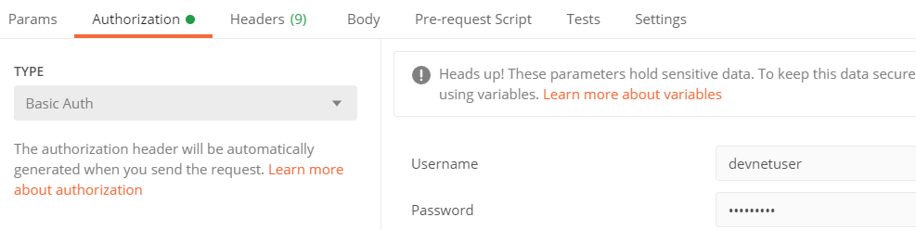
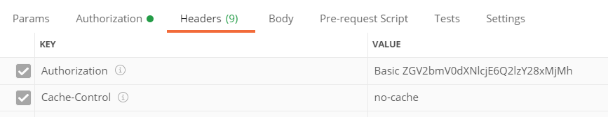
Basic authentication
Username and password
Easy to implement
Static username/password
Difficult to rotate/change
Considered not very secure
Not used in prod. Internet-facing apps
Used in most API-enabled network devices
OK for PoC, test apps in internal network
Converted into Base64 format
and sent in Auth header
Value is Basic<space><token>
Notes:
Easy to implement, most simple API-enabled devices, such as routers, Cisco or Juniper, use basic authentication.
Due to static credentials, this is not considered very secure, so in production enterprise or Internet-facing applications or any controllers this method is hardly ever used.

Slide 5
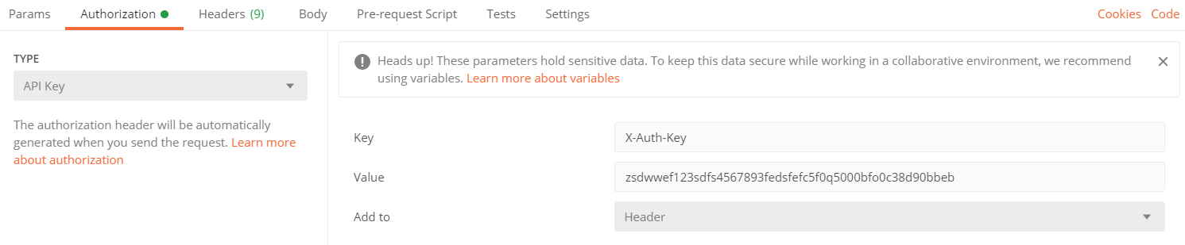
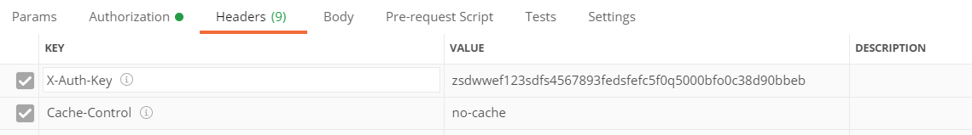
API Keys
API Keys are similar to Basic
Created per application, not user
Don’t expose real user/password
Disallow access using other methods
such as SSH, console
Flexible, can be configured with
very granular access to specific resources
Easier to revoke
Also not the most secure method
Often used as first step in OAuth
Sent in a custom header like this:

Slide 6
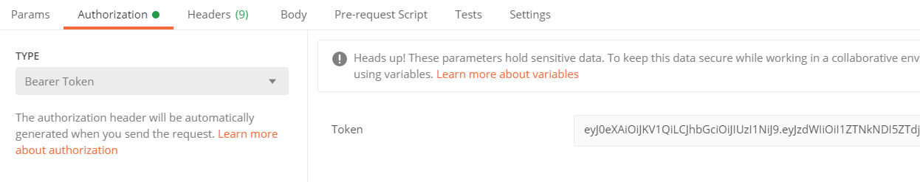
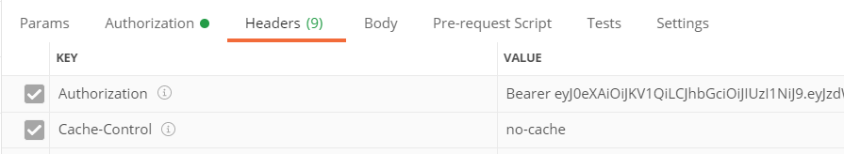
Bearer (Token) Authentication
Uses Token
Usually short-lived (hours)
In most cases returned by the server
in response to API call – login request
Used in OAuth2, we’ll discuss it later
Like Basic, sent in Auth header
Value is Bearer<space><token>

Slide 7
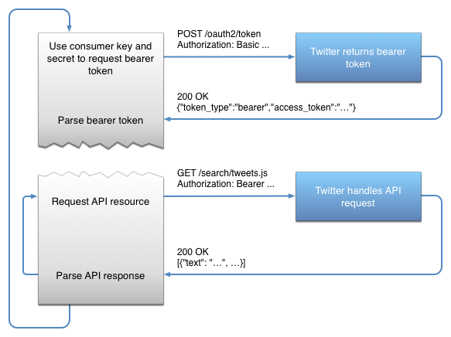
OAuth
Two-steps procedure
First request to obtain a token to a special Auth service
Basic Auth is used at this step, normally not username/password,
but API keys – client ID and client secret
- OAuth server can be the same organization or third-party
Possible to use MFA
--------------------------------------------------------------------------
Second request to the actual API endpoint with
Bearer values as Token received in the first step
Token has limited time, usually hours
No API keys or usernames are exposed, only this temporary token
Considered the most secure and scalable method, used by all public cloud providers and most of SaaS providers
https://developer.twitter.com/ja/docs/basics/authentication/overview/application-only
Notes:
The process consists of two steps.
First step is to get Authentication token.
At this step the client send a request to special API authentication URL with Basic Authentication, so it send usually API keys, but can send username/password.
The server validates credentials and returns token, you can see on the diagram, its on the top side.
The client parses this token and send next request to the actual API, and this time is sends this token in Authorization header (Bearer)
The main advantage of this method is that for every request the client uses token which is temporary, and usually has several hours lifetime.
The risks of compromising the credentials are greatly reduced, because once you get this temporary token, it’s used for potentially thousands of API calls, and then automatically rotated, or refreshed in API terminology.
Another big advantage it that the authentication server and API server can be different, so if you develop an application and would like to integrate with MFA, you don’t have to build your own MFA solution.
Instead, use existing API authentication server such as Okta or Auth0.

Slide 8
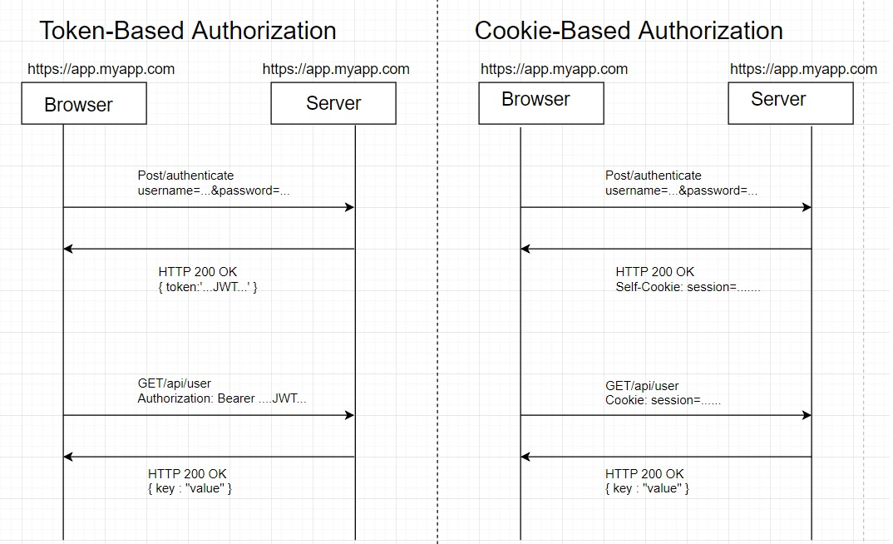
Cookies
Cookies
Similar to token-based auth
Also two steps: first to receive secure string (cookie) and then use this sting as authenticator
Considered not very scalable, as difficult to handle cross-domain or cross-app comms
Used in vManage and vCentre, as the auth server and the app are in fact the same
https://labs.tadigital.com/index.php/2019/05/16/web-security-authentication-cookies-vs-tokens-vs-html5-web-storage/
Notes:
Cookies use the similar approach as Token-based Authentication
There are also two steps – authentication and next step is the actual request using unique session ID which is the cookie , the main difference is the server used at step 1 and 2 is the same.
The reason is that due to security considerations, it’s normally prohibited to use cookies from one site on another.

Slide 9
Combination of several methods
Multiple Headers:
curl https://api.cloudflare.com/client/v4/zones/cd7d0123e301230df9514d \
-H "X-Auth-Key: 1234567893feefc5f0q5000bfo0c38d90bbeb" \ <<<<< API Key
-H "X-Auth-Email: example@example.com“ <<<<< plus additional Header
Combination:
curl -X POST "https://172.21.36.35:8443/dataservice/device/action/software" \
-d '{"platformFamily":"c1100"}’ -b cookies.txt -H "X-XSRF-TOKEN: $TOKEN" -H "Content-Type: application/json“
^^^^^ ^^^^^^^^^^^
Cookies file AND Custom Header
Summary - Auth methods depend on the application, no standard ways, check the documentation for the application

Slide 10
Practice Time
We’ll use Cisco DNA Centre Sandbox and ServiceNow Dev instance
cURL and then Postman

Slide 11
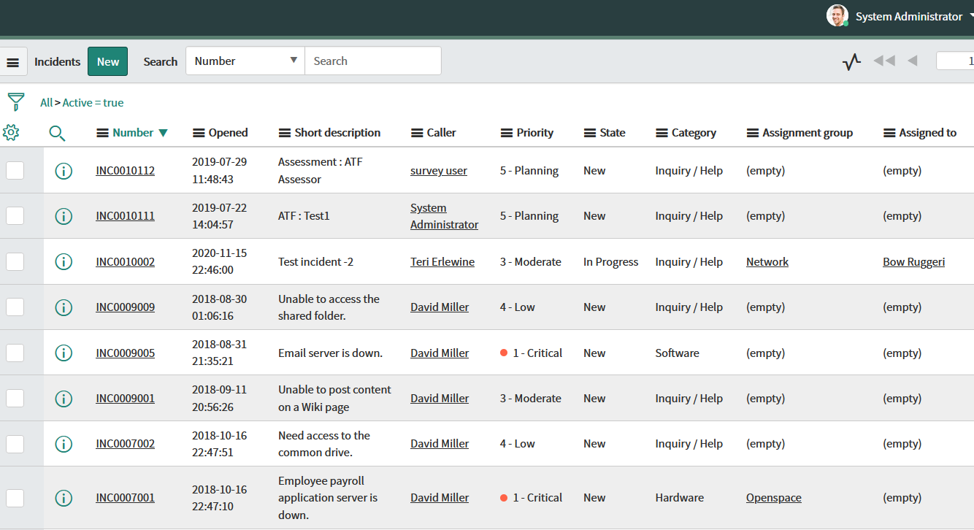
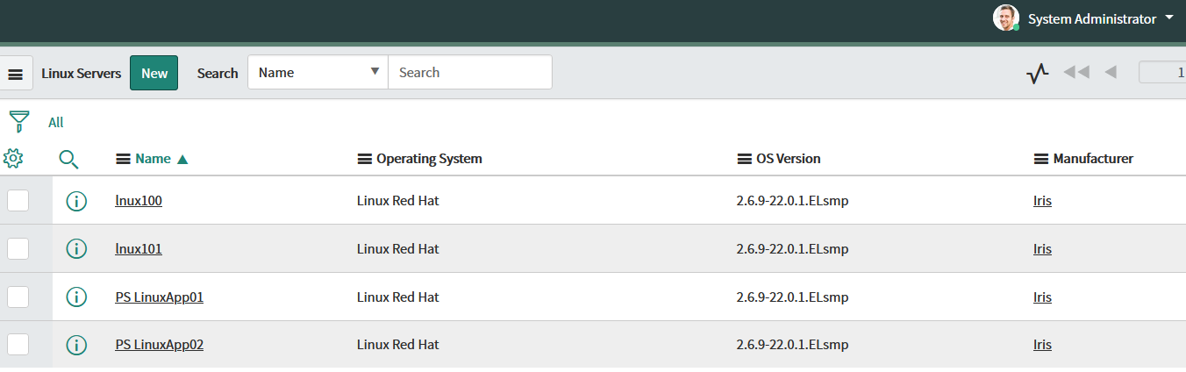
ServiceNow
We’ll be using demo instance I created for testing, but you can create your own: https://developer.servicenow.com/
https://dev78092.service-now.com/navpage.do
We’ll use Incidents and Linux Servers tables
ServiceNow supports Basic Auth and OAuth,
we will use Basic

Slide 12
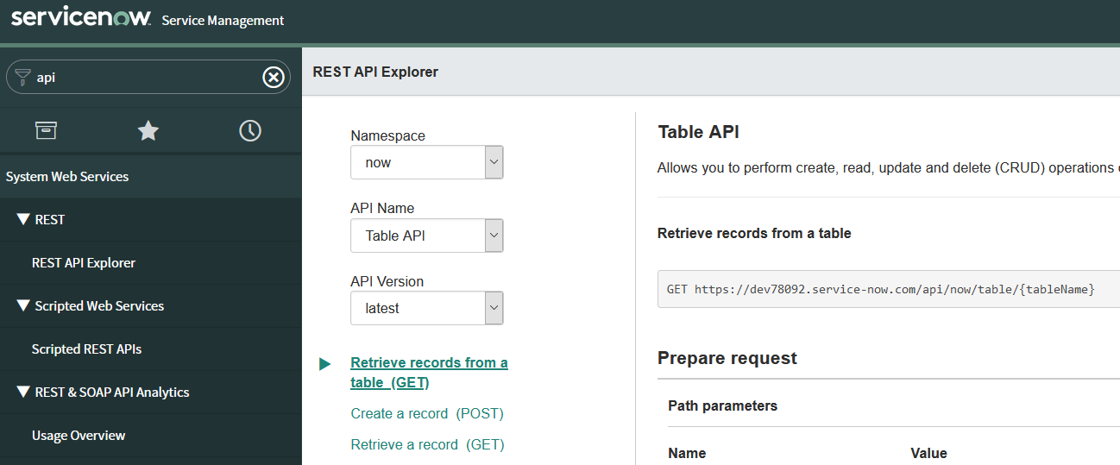
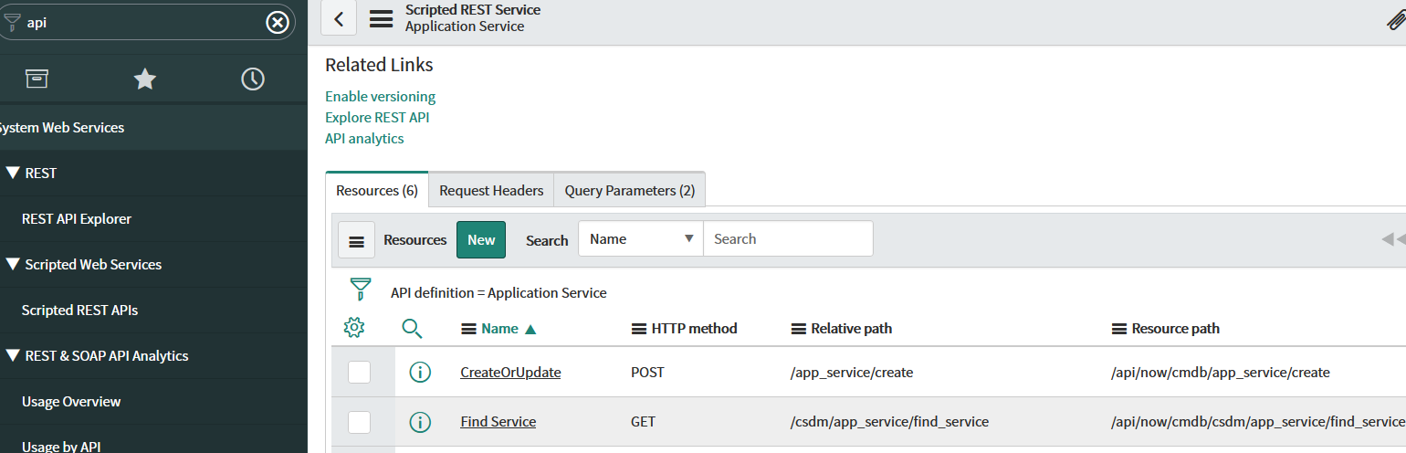
ServiceNow API Doc
Search for API
You can try real API calls

Slide 13
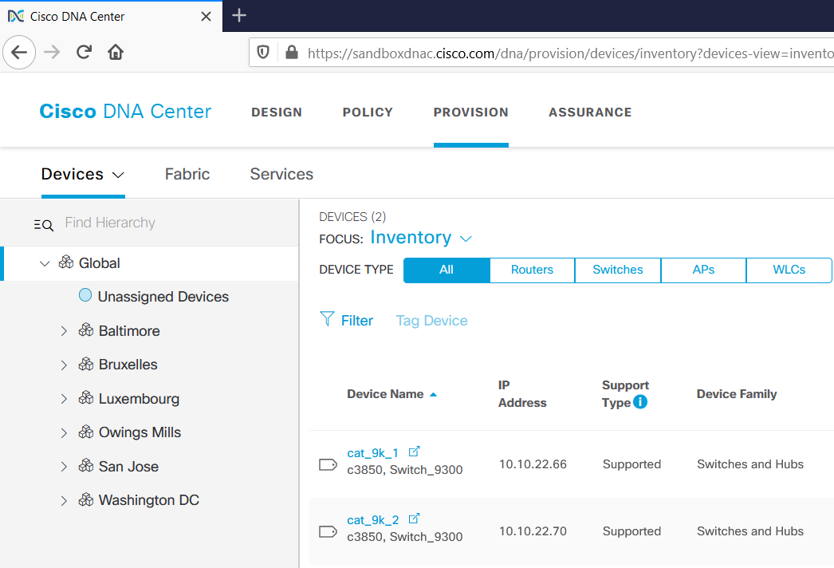
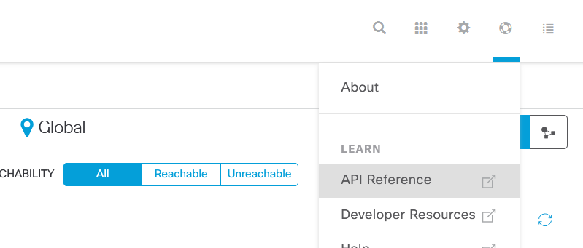
Cisco DNA Center
Cisco DNA Centre Sandbox
https://sandboxdnac.cisco.com
Live instance
Only GET requests
Login – devnetuser
Password – Cisco123!
Supports OAuth
API documentation:
https://developer.cisco.com/docs/dna-center/#!cisco-dna-center-platform-overview/intent-api-northbound
Notes:
Cisco DNA Centre is a management system for Cisco LAN infrastructure.
As you can the credentials are publically available and with these credentials the platform supports GET requests
Also you can check the documentation which is called Northbound API, remember from last session there are Northbound and Southbound APIs.

Slide 14
Practice Basic Auth with Service Now
Basic Auth - see https://dev78092.service-now.com/$restapi.do#/code_modal
curl –v "https://dev78092.service-now.com/api/now/table/incident?sysparm_limit=1" \
--request GET \
--header "Accept:application/json" \
--user 'api_user’:’secret-here'

Slide 15
Practice custom Auth Header with Cisco DNAC
https://sandboxdnac.cisco.com
Username: devnetuser
Pass: Cisco123!
Step 1 - get Token from Auth API endpoint :
curl -k --request POST --url https://sandboxdnac.cisco.com/dna/system/api/v1/auth/token --user 'devnetuser':'Cisco123!'
OR
TOKEN=$(curl --insecure --request POST --header "Authorization: Basic $(echo -n devnetuser:Cisco123! | base64)" \
https://sandboxdnac.cisco.com/dna/system/api/v1/auth/token -v \
| python -c "import sys, json; print json.load(sys.stdin)['Token']")
echo $TOKEN
Step 2 – make request using this token in header x-auth-token:
curl -k --location --request GET 'https://sandboxdnac.cisco.com/dna/intent/api/v1/network-device' --header "x-auth-token: $TOKEN" -v | python -m json.tool

Slide 16
Requests to try for vCentre and vManage
vCentre – Non Prod:
read -s PASS
curl -k -u nonp-username@nonp.nttict.com.au:$PASS -X POST https://10.7.142.15/rest/com/vmware/cis/session -c cookie.txt
curl -k -b cookie.txt https://10.7.142.15/rest/vcenter/vm | jq
OR curl -k -b cookie.txt https://10.7.142.15/rest/vcenter/vm | python -m json.tool
vManage - Demo:
read -s j_password
curl -v --request POST -k --url https://172.21.36.35/j_security_check --data "j_username=username&j_password=$j_password" -c cookies.txt
curl -k -b cookies.txt --url https://172.21.36.35/dataservice/server/info
for POST requests to vManage use additional token:
TOKEN=$(curl -k -b 'cookies.txt' --url https://172.21.36.35/dataservice/client/token)
echo $TOKEN
curl -k -vvv -X POST "https://172.21.36.35:8443/dataservice/device/action/software" \
-d '{"platformFamily":"c1100","controllerVersionName": "20.1.x", "versionName":"17.2.2", "versionURL":"http://t.blob.core.windows.net/images/c1100-universalk9.17.02.02.SPA.bin"}’ \ -b cookies.txt --insecure -H "X-XSRF-TOKEN: $TOKEN" -H "Content-Type: application/json"
Notes:
Some requests to try at home :)
See here how vManage and vCentre use cookies, so again first request is POST to request a cookie or Token, and second is the actual request to API endpoint

Slide 17
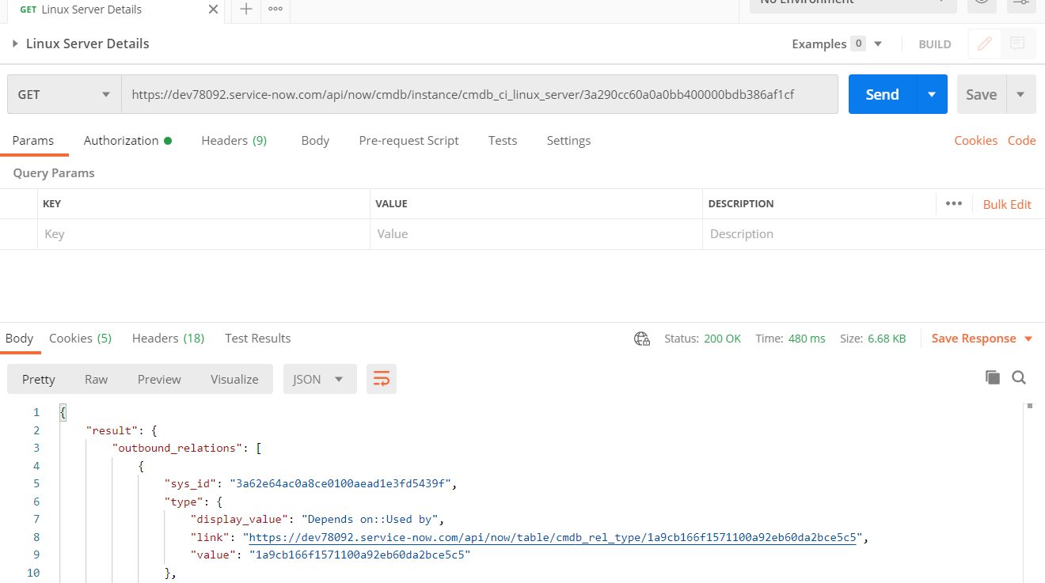
Postman
We tried using API in CLI, let’s use a UI client which is Postman
Postman is very popular API querying and testing tool.
Request
---------------------------------
Response
https://learning.postman.com/docs/sending-requests/requests/
https://www.guru99.com/postman-tutorial.html
Notes:
The top part is Request and the bottom is Response.
Each Part has tabs to show Headers, Body and some other parameters.
Postman is a very powerful tool, it supports JSON parsing, request chaining, test suites, scripting using Javascript language.
We’ll only cover basics

Slide 18
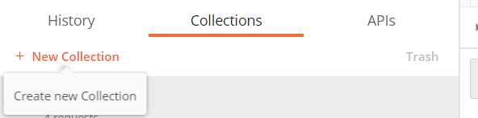
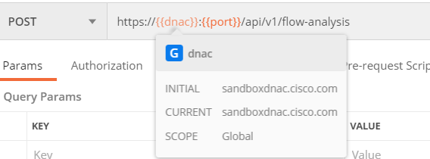
Postman – main features
Organise Requests to collections – like folders
Variables – often used in URLs, especially where you
use the same requests to different systems
For example, we have multiple vManage controllers,
and need to make the same requests, easier not to
hardcode URL/port, but use variables
Format is {{variable}}
Notes:
Group your requests into Collections from the beginning, as the number of requests can be pretty big and it’s easy to lost.
Variables are often used in URLs, especially where you use the same requests to different systems.

Slide 19
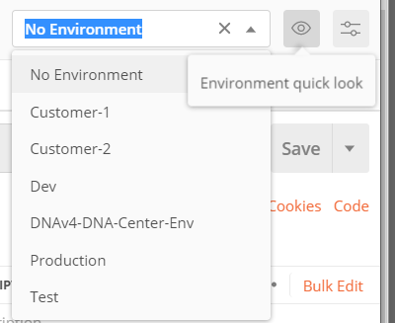
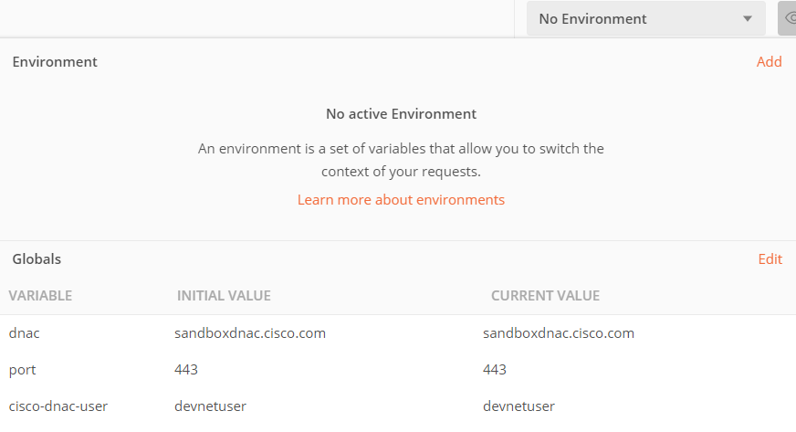
Postman – Environments and Global
Two methods to set values to variables
Environments – define variables for each env, so you can switch between them and variables will be assigned different values
Globals – fixed
Not dependent on env
Notes:
How to define these variables?
There are two methods.
1. Environments, assign specific variable values and then switch between them, so for example, to use different URLs, you can switch between different customers or between prod and test.
When you switch between the Environments, variables are automatically updated.
2. Globals.
It offers fixed variables, not so flexible, but easier.

Slide 20
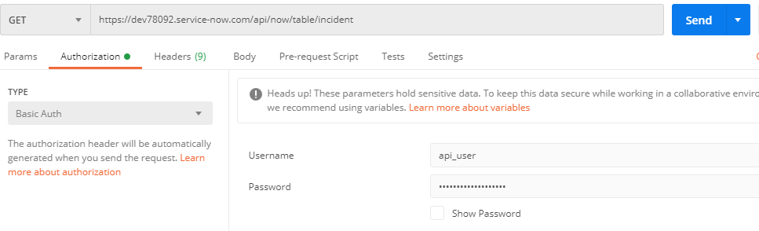
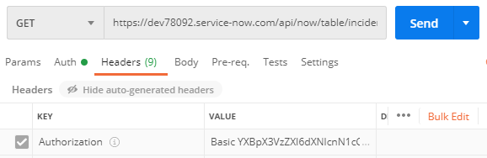
Practice with ServiceNow – Postman - GET
Enter URL https://dev78092.service-now.com/api/now/table/incident
Go to Auth Tab
Auth Type - Basic
Username –api_user
Password – in Teams
Go to Headers Tab
Note Auth Header is populated with Base64 value
Click Send
Check the response code and Body content

Slide 21
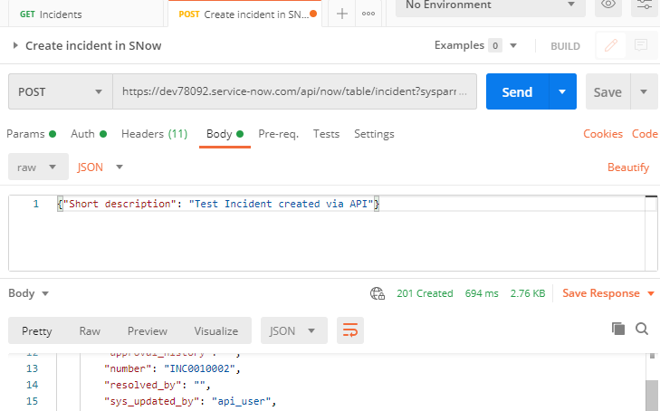
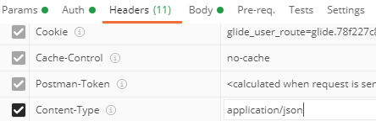
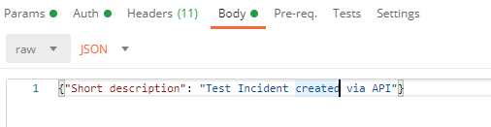
Practice with ServiceNow – Postman - POST
1. Go to Auth Tab – the same as previous request
Go to Headers Tab
Create Key Content-Type application/json
2. Go to Body Tab
Change type to JSON and enter
{"Short description": "Test Incident created via API"}
3. Click Send
Note you get response code 201 and INC number in Body
Notes:
https://community.servicenow.com/community?id=community_blog&sys_id=0f5de629dbd0dbc01dcaf3231f9619ca

Slide 22
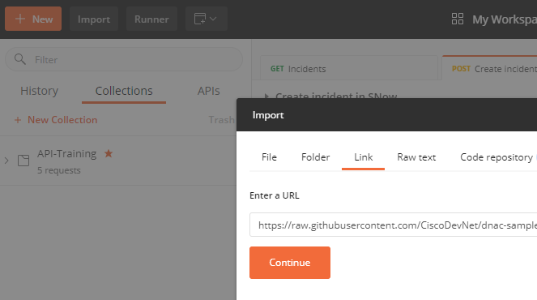
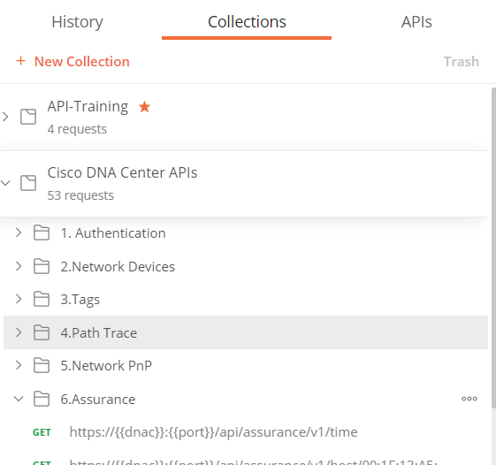
Practice with DNA Centre Sandbox - Postman
Top left corner - Import –> Link
https://raw.githubusercontent.com/CiscoDevNet/dnac-samples-aradford/master/tools/postman/01-DNAC-Sandbox.postman_collection.json
Note you have a new collection
https://github.com/CiscoDevNet/dnac-samples-aradford/
https://developer.cisco.com/site/dnac-101/
Notes:
https://github.com/CiscoDevNet/dnac-samples-aradford/
https://developer.cisco.com/site/dnac-101/

Slide 23
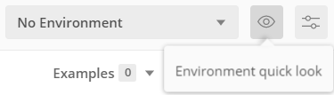
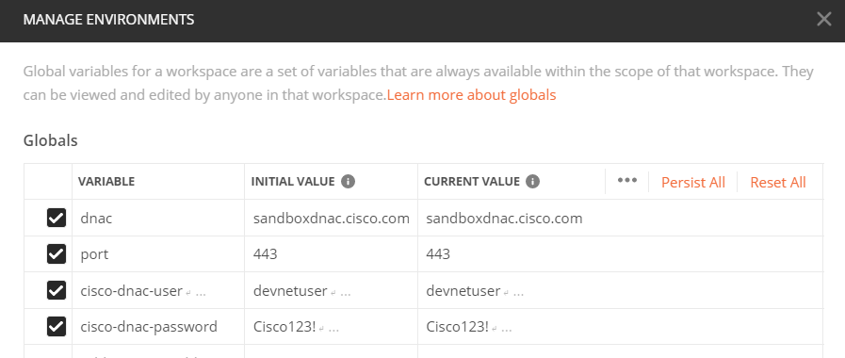
Practice with DNA Centre Sandbox - Postman
Click the eye icon and edit Globals

Slide 24
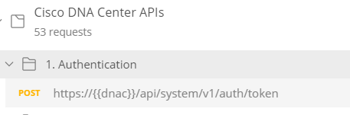
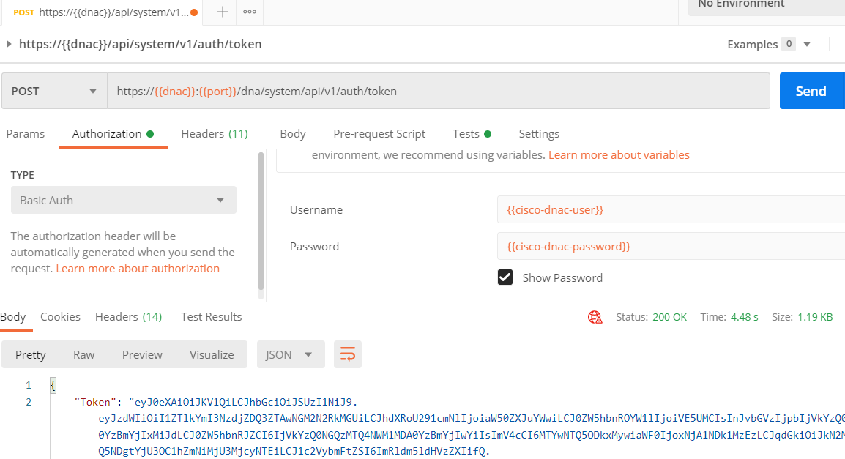
DNA Centre Sandbox
In Postman collections choose DNA Center and Authentication
---------------------------------
Find here four variables ☺
Hover over the vars to see if they have correct values
Click Send
See if you received status 200 OK
----------------------------------
Token will be in response body
Copy it – it will be used in the next step

Slide 25
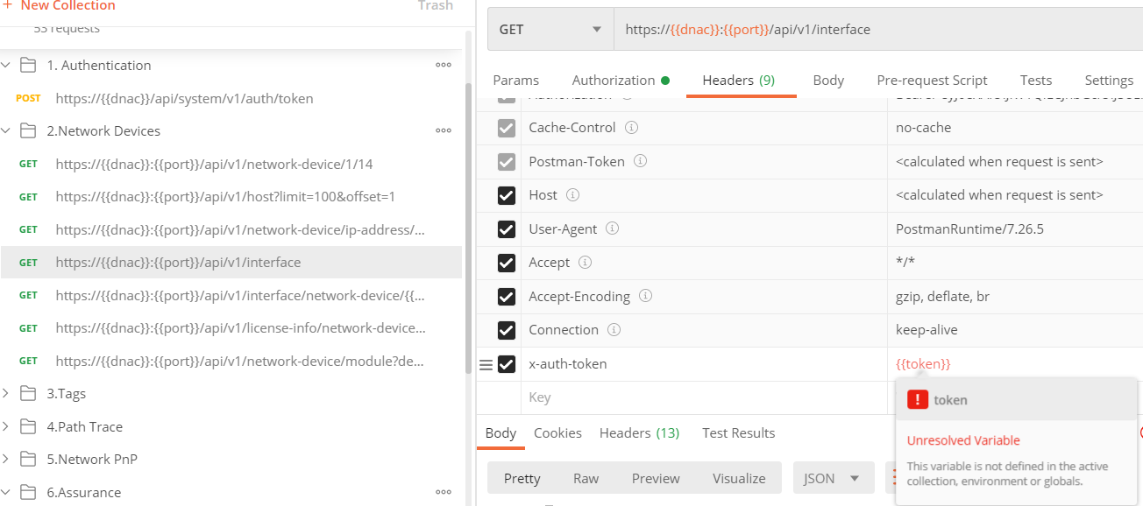
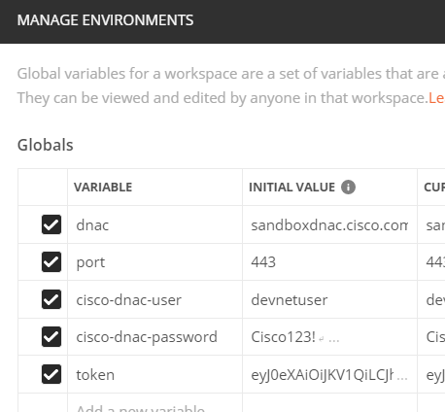
DNA Centre Sandbox
Once you get a token at the previous step
Choose any Get request
Switch to Headers tab
Note there is no token defined >>>>
Define the token as global variable

Slide 26
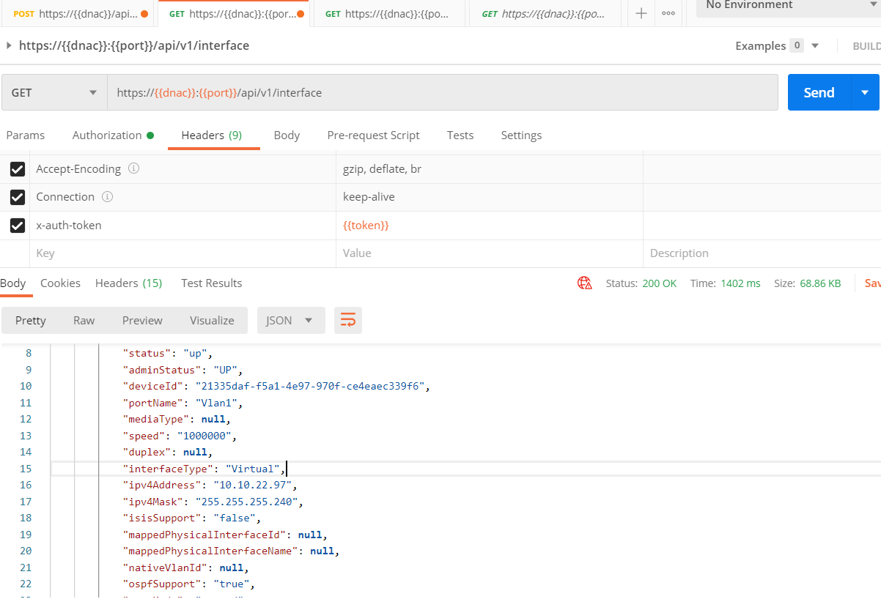
Final step
Click Send and see that you get Response code 200 OK and JSON data in body
If it’s not 200, but 401 or 403, check token value
Try other requests, check what headers you use in Requests and receive in responses

Slide 27
Summary and next steps
Today we covered API authentication and practiced Postman
In your free time practice with Postman, build a new collection and create the requests we tried in last session
Next session we’ll switch to Python and start with basics –virtual environments, data types and operations, and we’ll use IDE Pycharm
Please install python3
https://www.python.org/downloads/
and Pycharm Community Edition
https://www.jetbrains.com/pycharm/download/

